Slide 1
Orientation to: Data Integration and Visualization

Slide 2
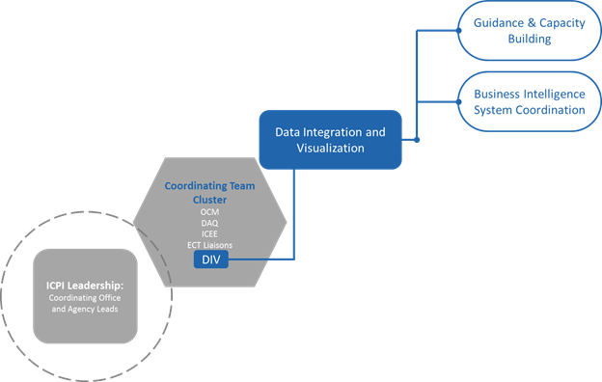
Data Integration & Visualization (DIV)
DIV is responsible for coordinating and developing best practices for data integration and visualization through two main sub-groups/pillars: 1) Business Intelligence, and
2) Guidance and Capacity Building.

Slide 3
Business Intelligence
Panorama
Analytic Workspaces
Dossiers testing and transition

Slide 4
What are ICPI tools?
Summarized data reported to PEPFAR for required indicators by country and at various geographic levels – can be filtered by agency, partner, etc. Sometimes includes qualitative narratives reported.
Includes MER, SIMS, Geospatial analyses
Created using R, Stata, SAS, Excel, Tableau, etc.
Some visuals in Panorama created with ICPI support
Audience: HQ and field

Slide 5
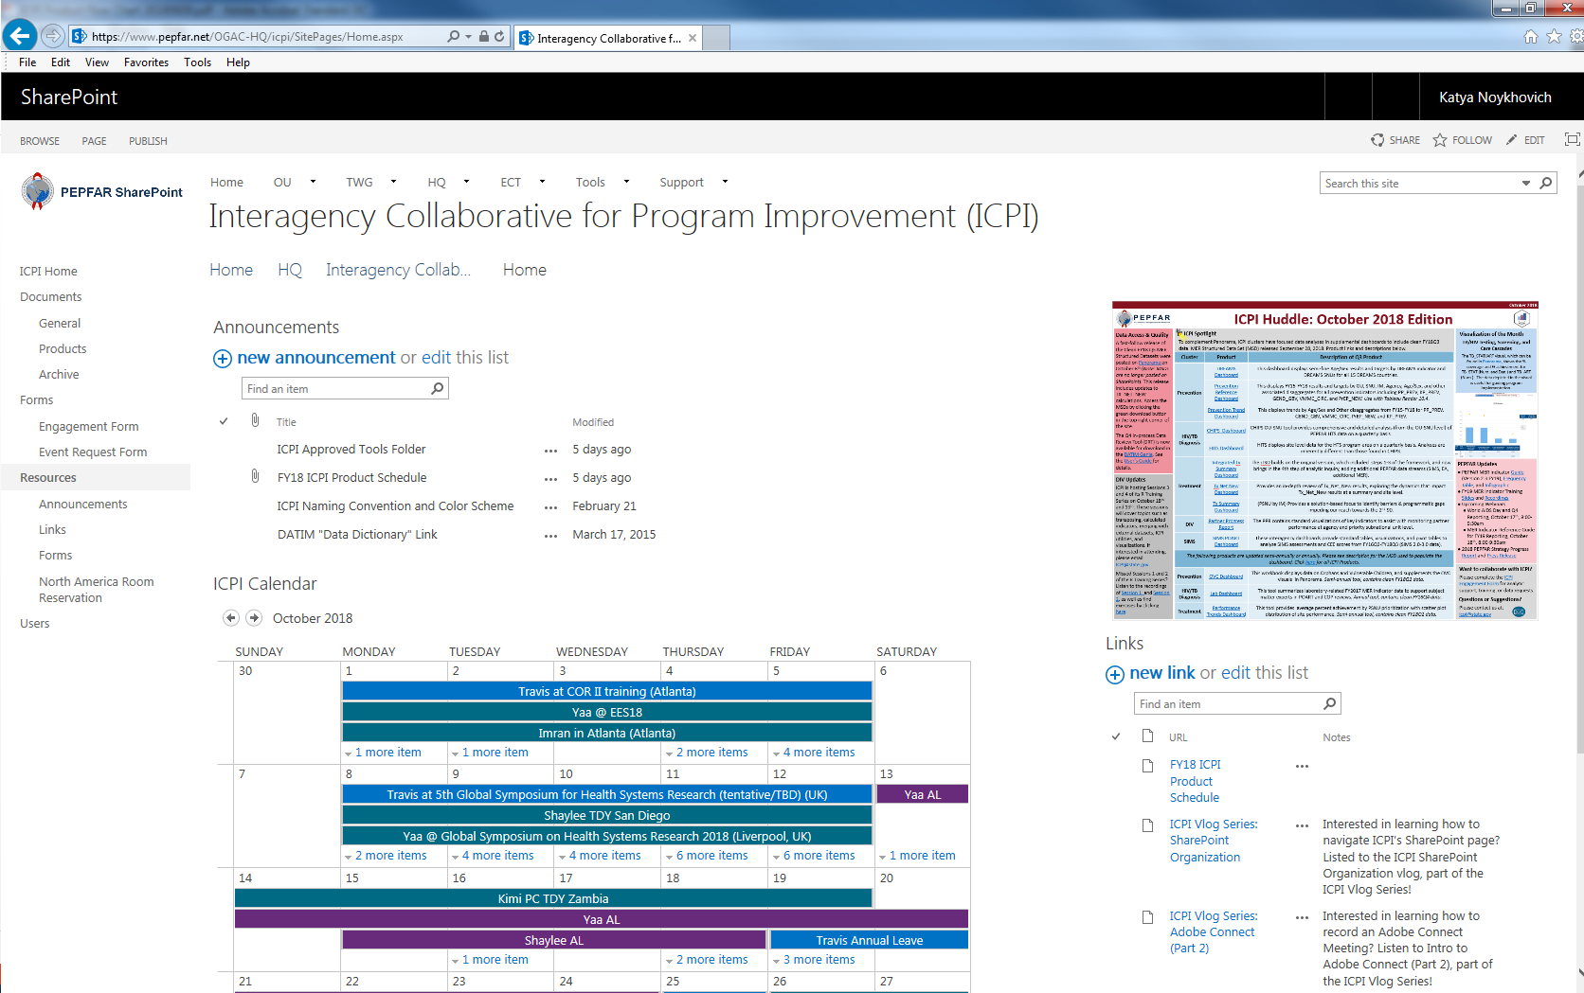
Where do I find ICPI Tools?
Pepfar.net → HQ → ICPI → Products → ICPI Approved Tools
ICPI Huddle
Individual tool folders
ICPI Huddle
products

Slide 6
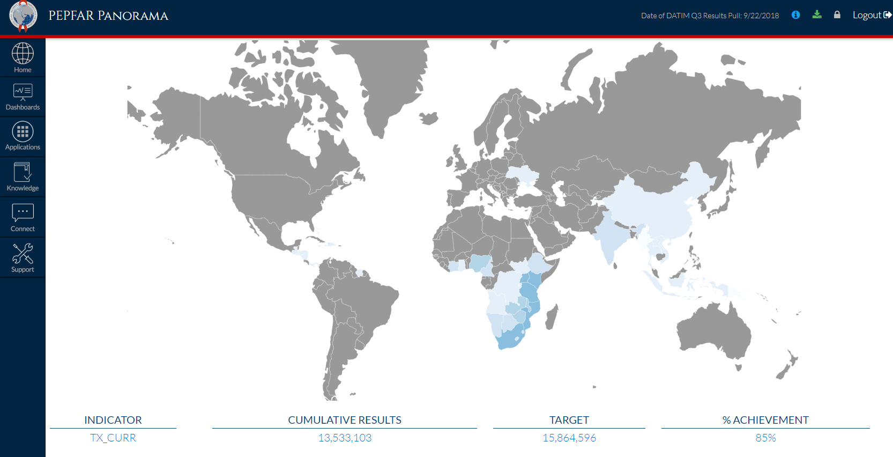
Also – PEPFAR data on pepfar-panorama.org

Slide 7
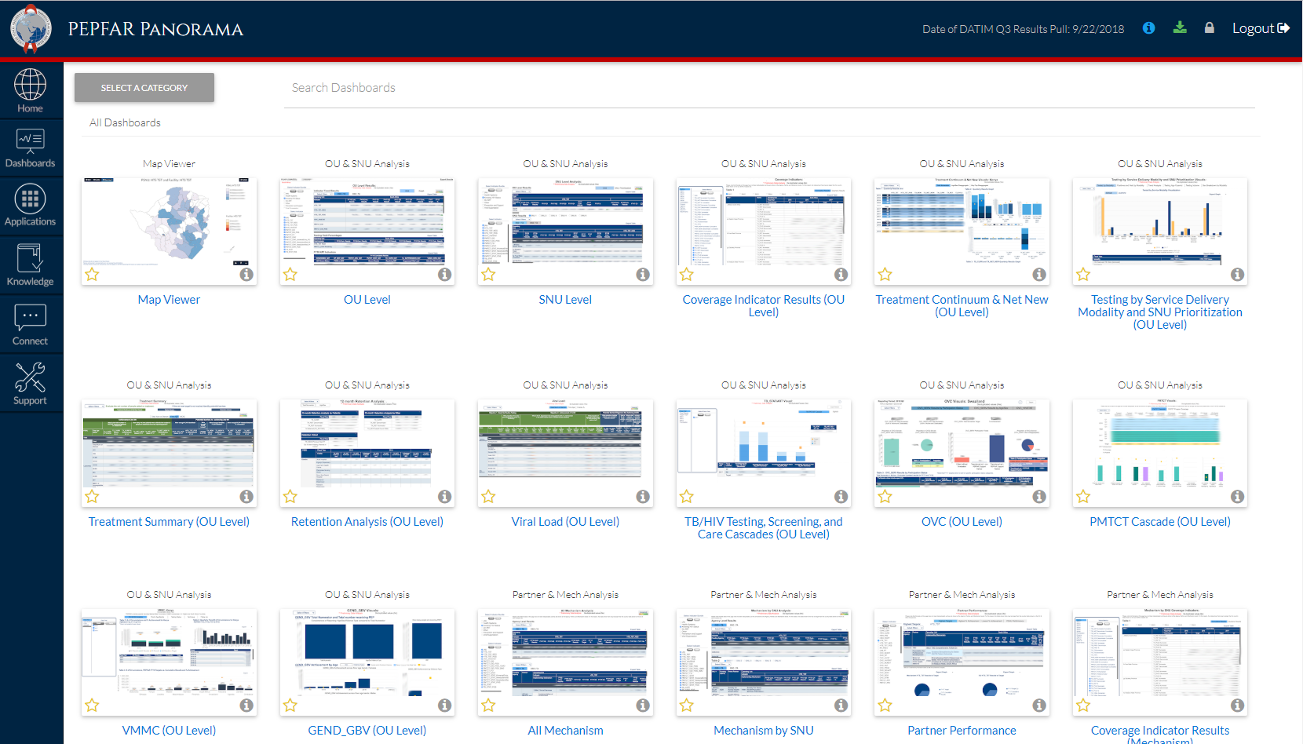

Slide 8
Which ICPI tool does what?
Check it out
ICPI Product Flow Chart (v.20180608)
ICPI Product Summary Library (v.20181018)

Slide 9
Guidance and Capacity Building Best practices
To help create cohesion around standard practices, the DIV produced a number of products around best practices. One of the first products provided guidance around file naming conventions so that it would be clear for all ICPI files, both internal as well as those that are disseminated, what the file contains, what operating units it relates to, and which MSD it was built off of. Regarding the MSD, the DIV, in collaboration with the Data, Access, and Quality (DAQ) Cluster produced guidance for setting up pivot tables with our PEPFAR data. Lastly, the GCB promoted ICPI's adoption of GitHub as a platform for both sharing code used in analysis and tool production as well as for program management. Best practices around using GitHub and creating repositories in GitHub. Moving away from our own created content, we also host a resources wiki which consolidates a lot of great guidance around data visualization, Excel, R, and GitHub.

Slide 10
Guidance and Capacity Building Style Guide
While producing a full style guidance is still a work in progress, the GCB has developed a few of the initial pieces in the process. The intent here is that all ICPI products would have a similar look and feel to them. One critical that helped with the rebranding of our products and ICPI in general involved the development of a new logo. Regarding more of the ICPI products, we created a number of ICPI color palettes to create uniformity across our products. The team also created a vlog on the ICPI color palettes.

Slide 11
Guidance and Capacity Building Workshops
The GCB has put on a number of workshops or brownbags in the past year. We have hosted a participatory session on structuring the back-end of Excel our tools. To promote best practices with GitHub, we have put on two trainings on GitHub for project management and GitHub for data science. The team also put on two "Show and Tell" workshops, going into the benefits of tool automation as well as on how to take advantage of custom made functions and packages by using the ICPIutilities package in R.

Slide 12
Guidance and Capacity Building Trainings
In addition to a number of shorter workshops, the GCB heavily contributed to the coordination and production of a couple of multi-day trainings. The GCB produced a well received Tableau training and a 50 page training documentto accompany it. The GCB also produced two of a four part R training for both ICPI analysts and headquarter users. In addition to the great trainings the team developed, we also created a training dataset, which masks the PSNU and IM data pulled at random from the MSD, to be used in both trainings as a manageable-sized and anonymous dataset as well as for public or demonstration materials.

Slide 13
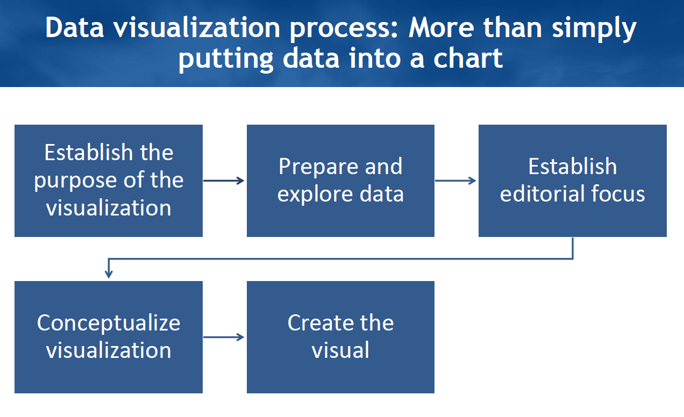
Source: Data viz: the good, the bad, the ugly

Slide 14
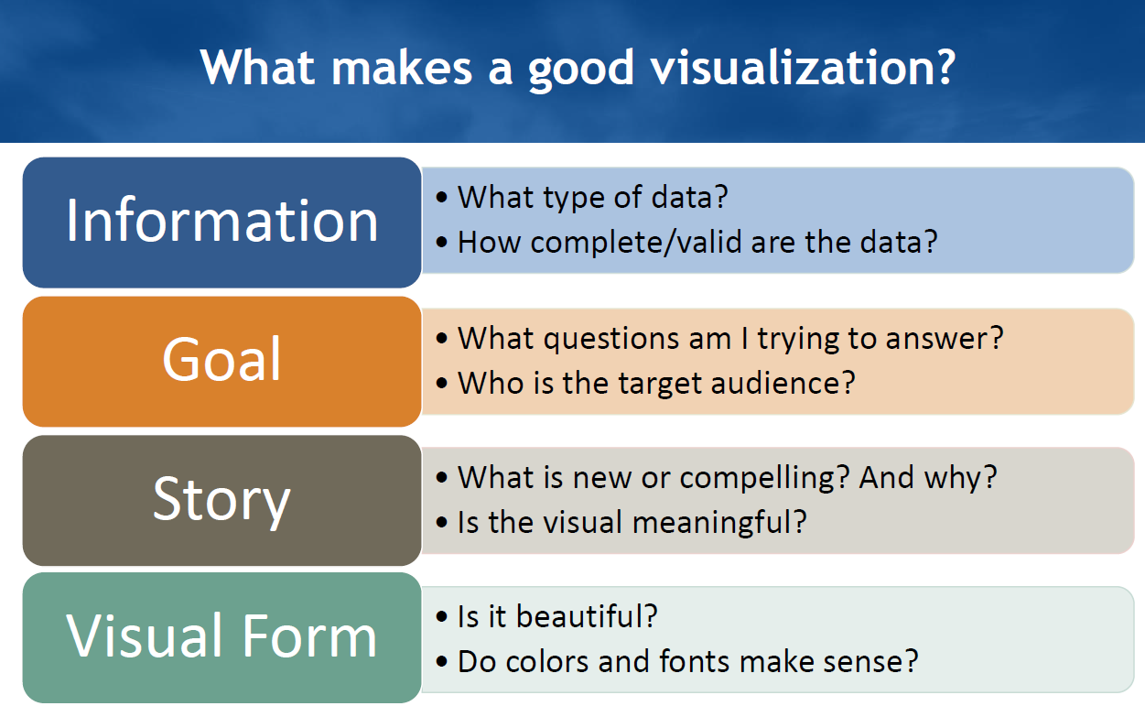
Source: Data viz: the good, the bad, the ugly

Slide 15
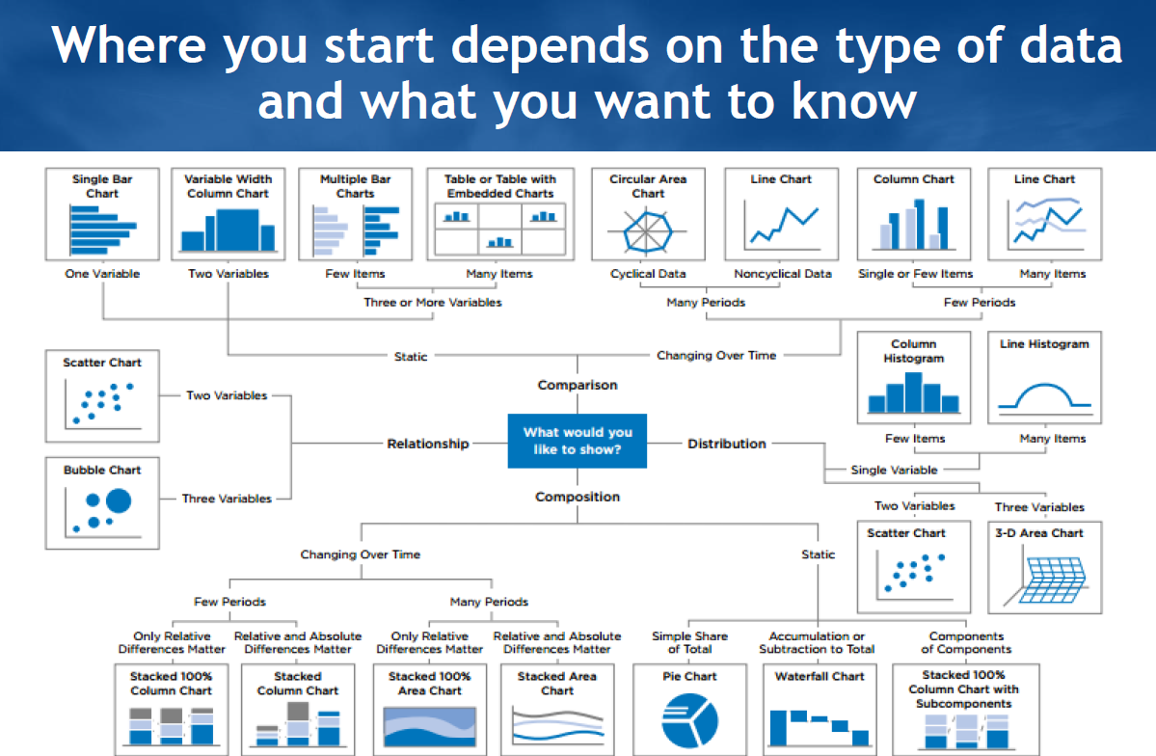
Source: Data viz: the good, the bad, the ugly

Slide 16
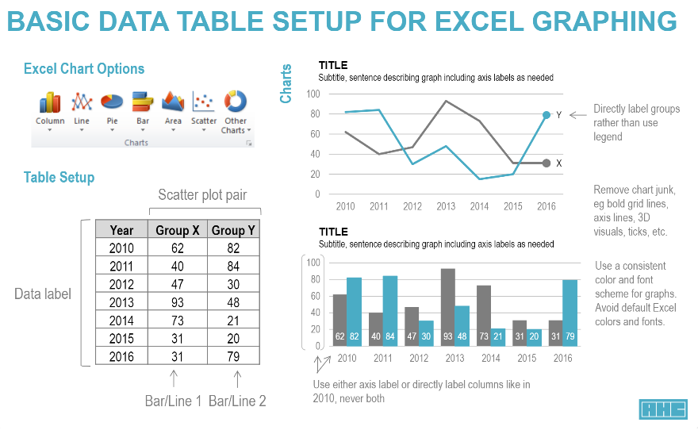
Source: DIV Best Practices

Slide 17
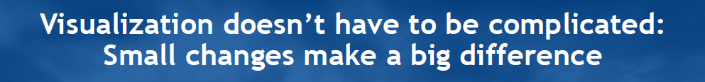
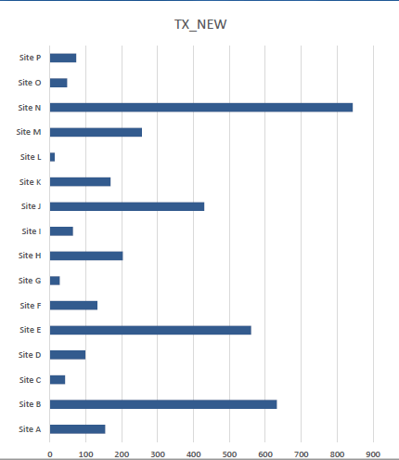
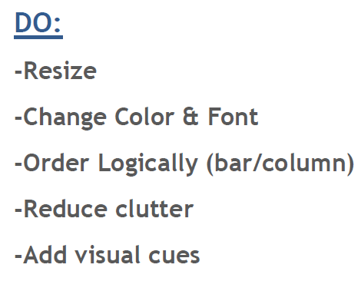
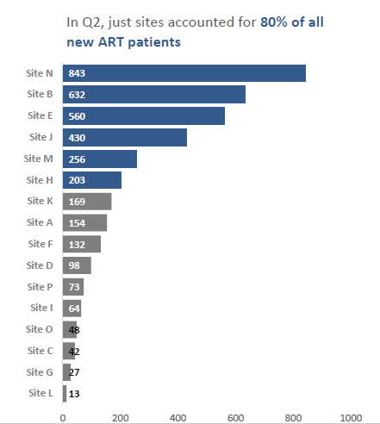
Source: Data viz: the good, the bad, the ugly

Slide 18
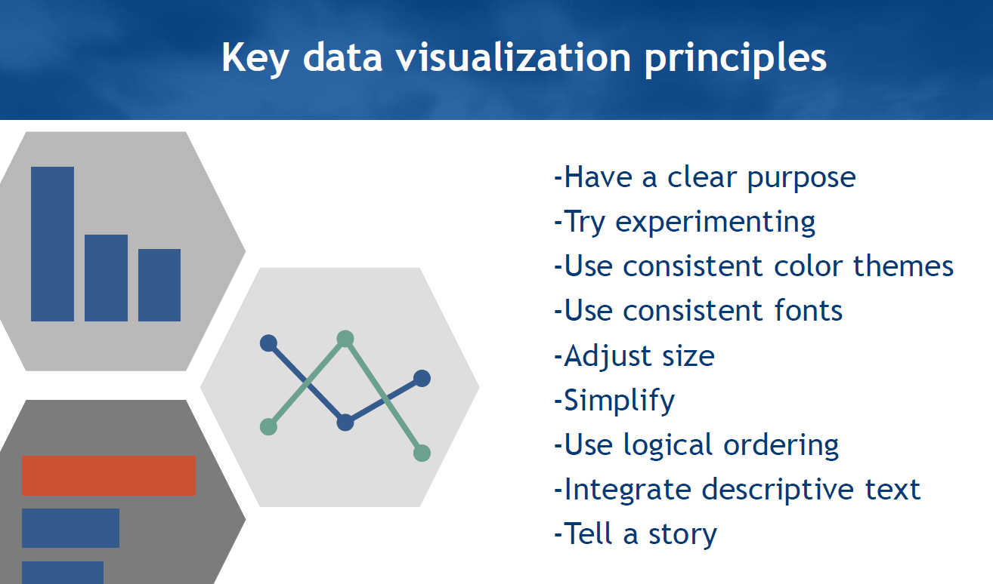
Source: Data viz: the good, the bad, the ugly

Slide 19
Data Viz: General Tips & Resources
Subset data (sample code for manipulating datasets)
Automate dashboards/tools when possible (replication & ease of use)
Documentation of analytics & setup of tool (code, instructions, etc.)
Standardization of colors, visuals for various purposes
Verify QC of analyses against Panorama/Datim
Sharing best practices – what does the audience/user have access to (software, knowledge of data, etc.)

Slide 20
Additional Resources and Materials
Resources for Excel, R, Data Viz, Stata, others
ICPI GitHub page, additional code for ICPI tools stored in each cluster’s page
PALS (PEPFAR Applied Learning Summit): (login to DATIM) Sept.2017 one-week training on data systems, analytics and visualization
DGHT presentations
Data viz: the good, the bad, the ugly
SIMS: hands-on demo

Slide 21
Recent ICPI Trainings
R functions & utilities for MER data
Purpose: Aimed at analysts who use R Studio, intends to take advantage of code that already exists for working with MER Structured Datasets. For more information, please see GitHub: https://github.com/ICPI/ICPIutilities​
R Training series 1-4
R Peer-to-Peer Training (January 2018)
Tableau training: Visualizing PEPFAR data (June 2018)

Slide 22
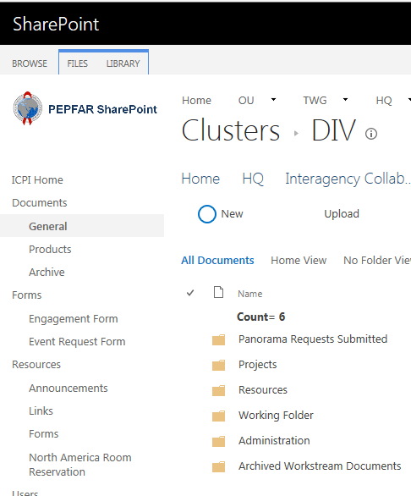
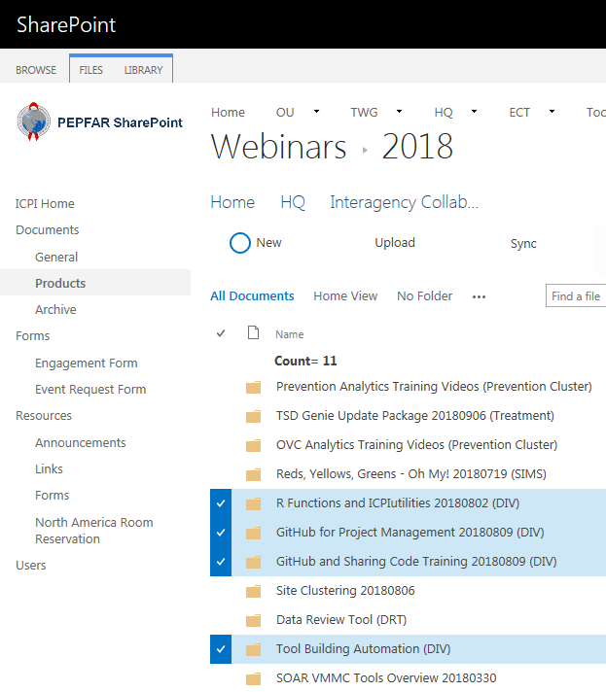
Where to find DIV materials?
GitHub: https://github.com/ICPI/DIV
DIV Wiki: Contains resources and meeting notes
DIV issues: Current and closed out projects and activities Organized by DIV subgroup: https://github.com/ICPI/DIV/projects
DIV outcomes/products: contains compilation of best practices, color palettes, ICPI logo, DIV presentations and trainings, and reference materials
Pepfar.net
DIV Cluster folder on pepfar.net
Administration → SOW, workplan
Contains: Working Folder, Completed Projects, Panorama Requests, resources
DIV Products on pepfar.net: Training webinars and brown-bags

Slide 23
Selected presentations from PALS to check out
Day | Session | Description
1 | Overview and Preparation for Analysis MER 2.0 Data: Level 1 | This session is divided into three concurrent sessions based on participant familiarity with a) PEPFAR indicators and concepts, and b) PEPFAR data systems, and is a precursor for Day 2 programmatic sessions on MER analysis. Level 1 will cover the relationship between MER 2.0 indicators and DATIM (data entry screens and relationship with other systems), OU hierarchy and essential data pulls (DATIM pivots and favorites), followed by a brief introduction to DATIM group sets and Panorama.
1 | Overview and Preparation for Analysis MER 2.0 Data: Level 2 | This session is divided into three concurrent sessions based on participant familiarity with a) PEPFAR indicators and concepts, and b) PEPFAR data systems, and is a precursor for Day 2 programmatic sessions on MER analysis. Level 2 offers more advanced practice with DATIM and will focus on using new analytic capabilities (group sets) for analysis.
1 | Overview and Preparation for Analysis MER 2.0 Data: Level 3 | This session is divided into three concurrent sessions based on participant familiarity with a) PEPFAR indicators and concepts, and b) PEPFAR data systems, and is a precursor for Day 2 programmatic sessions on MER analysis. Level 3 will cover the context and purpose of MER FactView data sets and hands-on practice working with these data sets in Excel.

Slide 24
Selected presentations from PALS to check out
Day | Session | Description
2 | Plenary – Data Lifecycle, Review and Quality | In this plenary we will discuss the MER data lifecycle and various aspects of data review and data quality. We'll discuss types of data quality and programmatic review checks that can be done, tools and methods for reviewing data, and developing processes for reviewing data.
2 | Plenary – Analyzing SIMS | Participants in this course will learn to identify sources of SIMS data and reference documents for SIMS analyses, and learn to conduct SIMS analyses with available tools. This course will provide the foundation for the Data Integration course.
2 | MER Analytics/ Available Visualizations; Using Available Visualizations and Developing New Analyses: Key Populations Breakout Group | Participants will learn how to use Panorama, DATIM, and the KP Dashboard to review KP-specific MER indicators and disaggregates.
2 | MER Analytics/ Available Visualizations; Using Available Visualizations and Developing New Analyses: Clinical Cascade Breakout Group | This course defines PEPFAR MER Cascades, explains why they are important, and leverages existing PEPFAR tools to show how they can be used to analyze and better understand programmatic data. The course highlights Panorama, DATIM, and existing tools to dive into the full cascade, testing, PMTCT, and TB/HIV
2 | MER Analytics/ Available Visualizations; Using Available Visualizations and Developing New Analyses: Prevention/DREAMS/OVC Breakout Group | This course will explore MER analytics related to Prevention including OVC, DREAMS, and VMMC. Participants will be introduced to available tools and Panorama visualizations for each topic area.
2 | MER – Data Cleaning | This session will focus on resources to use for MER data cleaning such as key DATIM favorites; DATIM favorites paired with Excel templates; and the ICPI Data Review Tool (DRT), which is populated with site-by-IM Fact View data sets. Discussion will build upon content of Day 2 Plenary Session on Data Lifecycle, Review, and Quality with further discussion about types of data checks and their utility at various points in the data cleaning process.

Slide 25
Selected presentations from PALS to check out
Day | Session | Description
4 | Plenary – Why Integrate and Triangulate Data and Introduction of Data Integration Checklist | This plenary introduces triangulation as a tool by which teams can analyze multiple data streams to come to more informed decisions about their programs. The session covers both theoretical considerations regarding data triangulation as well as practical tips to jump-start your analysis.
4 | Country Panel: Integrated and Triangulated Use of PEFPAR HQ Data – Integrated Data to Inform Program Improvement | This panel gives countries an opportunity to showcase innovative analyses that bring together multiple data streams to draw more meaningful conclusions/recommendations for policy and programmatic change.
4 | Integrated and Triangulated Use of PEPFAR HQ Data: Key Populations Breakout Group | Participants will be provided with an overview of data sources used to improve KP programming and will work through examples of responding to program needs using multiple data sources.
4 | Integrated and Triangulated Use of PEPFAR HQ Data: Clinical Cascade Breakout Group | In this breakout session, teams will have an opportunity to analyze multiple data streams that relate to a specific programmatic area of interest. Teams will consider Expenditure Analysis and SIMS data alongside MER targets and results in the Clinical Cascade area.

